Slide 1
Ministry of Higher Education Kateb University Computer Science Faculty Teacher: Sadullah Karimi Prepared BY: GhulamRasool Rasa

Slide 2
Dunder or magic methods in Python
Python Magic methods are the methods starting and ending with double underscores ‘__’. They are defined by built-in classes in Python and commonly used for operator overloading.
They are also called Dunder methods, Dunder here means “Double Under (Underscores)”.

Slide 3
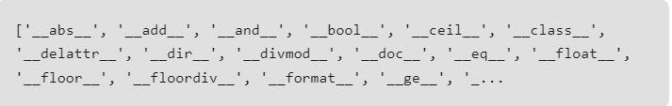
Python Magic Methods
Built in classes define many magic methods, dir() function can show you magic methods inherited by a class.
Example:
This code displays the magic methods inherited by int class.
print(dir(int))
Output:

Slide 4
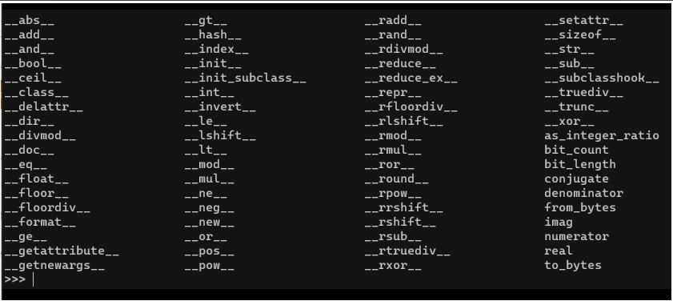
This lists show the Magic Method and their uses:

Slide 5
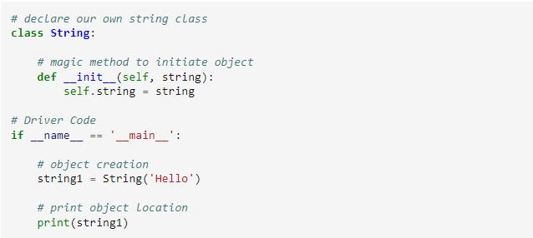

Now lets see some of the python magic method with examples:
1. __init__ method
The __init__method for initialization is invoked without any call, when an instance of a class is created, like constructors in certain other programming languages such as C++, Java, C#, PHP, etc.
These methods are the reason we can add two strings with the ‘+’ operator without any explicit typecasting

Slide 6
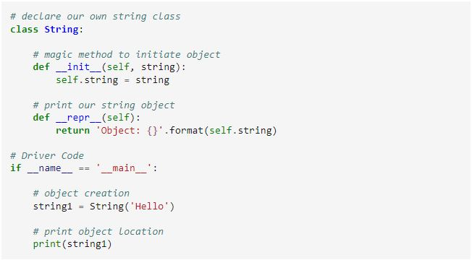

2. __repr__ method
__repr__method in Python defines how an object is presented as a string.
The below snippet of code prints only the memory address of the string object. Let’s add a __repr__ method to represent our object.

Slide 7
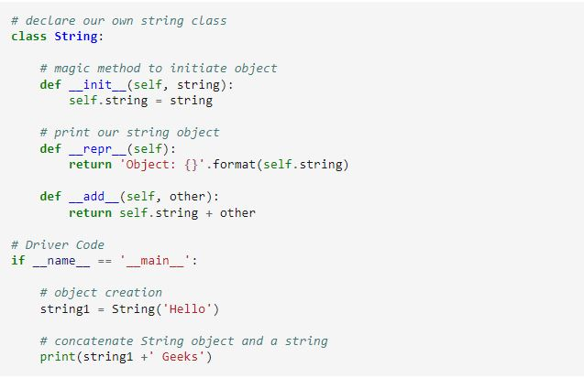

3. __add__ method
__add__method in Python defines how the objects of a class will be added together. It is also known as overloaded addition operator.
Now add __add__ method to String class

Slide 8
Thanks

